Slide 1
Data Analysis in Criminal Justice
Introduction; Types of Variables and Levels of Measurement

Slide 2
Science, Methods, & Replication
What is Science?
‘‘The process of gathering and analyzing data in a systematic and controlled way using procedures that are generally accepted by others in the discipline.’’
Methods? Replication?
Methods: Procedures used in processing and analyzing data.
Replication: Repeating methods with same data in an effort to achieve the same results.

Slide 3
The Wheel of Science
Theory
Theory
Induction
Deduction
Hypotheses
Findings
Data Analysis
Operationalization
Data Collection
Research
Design
Statistics
Measurement
Methodology

Slide 4
Types of Statistical Research
Evaluation
Examines program/law/law enforcement outcomes.
Exploratory
Examines unfamiliar topics lacking previous research.
Descriptive
Examines a particular phenomenon in a particular sample.

Slide 5
Populations and Samples
What is a Population?
‘The universe of people, objects, or locations that researchers wish to study.’
What is a Sample?
‘A subset pulled from a population with the goal of ultimately using the people, objects, or places in the sample as a way to generalize to the population.’
What is Probability Sampling?

Slide 6
Types of Variables and Levels of Measurement

Slide 7
Units of Analysis
What is a unit of analysis?
The objects or targets of a research study.
Examples:
A researcher is examining homicide patterns over time by gathering yearly city-level data for the years 1980-1985.
What is the unit of analysis?
A researcher is aiming to evaluate the effectiveness of ‘fighting back’ during a violent incident as it relates to injuries.
What is the unit of analysis?

Slide 8
Variables
What is a variable?
‘A characteristic that describes people, objects, or places and takes on multiple values in a sample or population.’
What makes a constant different from a variable?
A constant only takes on one value, whereas a variable takes on multiple values.

Slide 9
Level of Measurement
Level of Measurement & Computerization
Quantitative analyses require that data are computerized and numbers are assigned to all categories.
Level of measurement represents how these numbers are to be interpreted.
Are the numbers arbitrary, or do they have specific meanings?
Four Levels of Measurement
Nominal, Ordinal, Interval, Ratio (NOIR)

Slide 10
Nominal Variables
What is a nominal variable?
A variable whose numeric values can only be interpreted as representing distinct categories (i.e., 1=red; 2=blue; …).
What are the properties of these categories?
Distinct
Mutually Exclusive
Exhaustive
What are some example of nominal variables?

Slide 11
Ordinal Variables
What is an ordinal variable?
A variable whose values can be rank-ordered in terms of ‘more than’ or ‘less than’.
Values have a logical order:
Likert Scales:
Opinions – (1) Strongly Disagree; (2) Disagree; (3) No Opinion; (4) Agree; (5) Strongly Agree
Year in School – (1) Freshman; (2) Sophomore; (3) Junior; (4) Senior

Slide 12
Interval Variables
What is an interval level variable?
A variable whose distance between two adjacent values is fixed and known.
Allows more detailed descriptions of why one value is ‘more than’ or ‘less than’ the other.
Value of ‘0’ is arbitrary, and does not signal that the phenomenon in question is entirely absent.
0 degrees fahrenheit is not an absence of temperature.
What are some examples of interval variables?

Slide 13
Ratio Variables
What is a ratio level variable?
A variable whose value of zero is meaningful (making multiplication and division possible).
I.E., a homicide rate of 10 per 100,000 is twice that of 5 per 100,000.
What are some examples of ratio level variables?
Age
Years of education
Weight
Income

Slide 14
Review of Level of Measurement
Nominal | Ordinal | Interval | Ratio
Distinct
Exclusive
Exhaustive
 | Rank Order
 |  | Equal Intervals
 |  |  | True Zero

Slide 15
Levels of Measurement Examples
Property Crime Rate
Crime Type (violent, property, drug)
Sentence Length (in months)
Fear of Crime (1-10)
Conviction Status (convicted/not conv.)
Crime Seriousness (1-100)
Number of Arrests

Slide 16
Alternative Ways of Classifying Variables
Qualitative v. Quantitative
Qualitative
Variables tell us “what kind,” “what group,” or “what type.”
Gender, employment status, crime type
Quantitative
Variables tell us “how much,” or “how many.”
Work hours, age, sentence length (in months)

Slide 17
Alternative Ways of Classifying Variables (cont.)
Qualitative:
Nominal, Ordinal
Quantitative
Interval, Ratio

Slide 18
Alternative Ways of Classifying Variables (cont.)
Discrete v. Continuous
Discrete
Values assume only a finite or countable number of alternatives.
Family size, # of cigarettes smoked.
Continuous
Values can assume theoretically infinite number of values between any two points on a scale.
Crime rates per 100,000. GPA, temperature.

Slide 19
Alternative Ways of Classifying Variables (cont.)
Independent v. Dependent
Independent Variable (X) = “Cause”
Dependent Variable (Y) = “Effect”
REMEMBER:
An independent variable in one context could be a dependent variable in another, depends entirely upon the research question.

Slide 20
Examples
Nationwide, the average starting salary for entry-level police officers is about $24,000. You believe that the location of police departments in urban vs. rural areas influences starting salaries. In a random sample of 90 police departments, you find that the average starting salary is $25,000 in urban departments and $24,000 in rural departments.
Unit of observation = Police department
Population = All police departments in U.S.
Sample = 90 police departments
Dependent variable = Starting salary
Ratio level, continuous (also discrete)
Independent variable = Location
Nominal

Slide 21
Examples (cont.)
Many sociologists argue that poverty is a cause of criminal behavior. To test this claim, you collect data from a random sample of 250 counties across the U.S. You obtain measures of the poverty rate (% population living below poverty line) and the number of offenses reported to the police.
Unit of observation = County
Population = All counties in U.S.
Sample = 250 counties
Dependent variable = Number of offenses reported to police
Ratio level, discrete
Independent variable = Percent living below poverty line
Ratio level, continuous

Slide 22
Examples (cont.)
According to some theorists, teenagers who spend more time with their friends in unsupervised activities are more likely to engage in delinquent conduct. You question a random sample of 2,500 high-school youths about number of hours spent in unsupervised peer activities (e.g., cruising, shopping, movies) and frequency of delinquent behavior.
Unit of observation = Individual
Population = All high-school youth
Sample = 2,500 high-school youths
Dependent variable = Frequency of delinquent behavior
Ratio level, discrete
Independent variable = Hours in unsupervised peer activities
Ratio level, continuous

Slide 23
Why Does Level of Measurement Matter?
Level of Measurement determines what type of statistical test is appropriate.
Tests chosen based upon level of measurement of “X” & “Y”
Examples
X = Sex, Y = Employment → Chi-Square Test
X = Sex, Y = # of arrests → T-Test
X = Crime Type, Y = Sentence Length → F-Test
X = Divorce Rate, Y = Homicide Rate → Correlation & Regression

Slide 24
Data Visualization

Slide 25
Overview
How to efficiently summarize data
How to produce frequency distributions
How to produce graphs

Slide 26
Summarizing Data
Sample Size (n)
Total number of observations in a sample
Frequency (f)
Count or number of observations in a subset of the sample

Slide 27
Proportion & Percent
Proportion (p)
Ratio of the number of observations in a subset of a sample to the total number of cases in the sample (relative frequency)
Percent (%)
% = f/n X 100
P = | # in subset of sample | = | f
 | Total # of cases in sample |  | n

Slide 28
Ratios & Rates
Ratio
Expresses the relationship between two values, indicating their relative sizes.
2:1 indicates that the first value occurs twice as much as the second value.
Rate
Ratio of the number of occurrences of an event to the population at risk for experiencing the event,
Rate = (# of occurrences of event / estimated population) X 10 to some power.

Slide 29
Rates (cont.)
Birth Rates = X 10³ (per 1,000 women of childbearing age).
School expenditure = X 10º (per pupil)
Crime Rates = X 10⁵ (per 100,000 population)
In 1999, there were 409,670 robberies reported to the police, and the estimated population in the U.S. that year was 272,691,000
150.2 robberies per 100,000 population
(409,670 / 272,691,000) X 100,000 = 150.2

Slide 30
Rates (cont.)
Difference between a rate and a proportion?
Proportions cannot lie outside 0, 1 interval
Rates can be anywhere between 0 and infinity.
Denominator of a proportion is a fixed sample size (n)
Denominator of a rate is often an estimated population size.

Slide 31
Calculating Crime Rates
Which region had the most robberies in 1999?
Why does the South have more robberies?
More dangerous?
More people?
Region | Count | p
Northeast | 88,072 | .215
Midwest | 81,651 | .199
South | 150,817 | .368
West | 89,130 | .218
 | 409,670 | 1.0

Slide 32
Calculating Crime Rates (cont.)
Does the South also have the highest crime rate?
Northeast is actually more dangerous.
Rates account for differences in “eligible” population, or the “population at risk.”
Region | Count | Population | Rate per 100k
Northeast | 88,072 | 51,830,000 | 169.9
Midwest | 81,651 | 63,242,000 | 129.1
South | 150,817 | 96,470,000 | 156.3
West | 89,130 | 61,149,000 | 145.8

Slide 33
Proportional Difference
Proportional Difference (Change)
Comparison of a single variable across two time periods, or simply to compare the relative magnitudes of two values.
Typically multiplied by 100 to get % difference
% change = ((Time 2 – Time 1) / Time 1) X 100
Or, ((Comparison – Baseline) / Baseline) X 100

Slide 34
Proportional Difference (cont.)
Change in homicide rate
1994 Rate = 9.0 per 100,000
1999 Rate = 5.7 per 100,000
How large was the change in homicide?
% change = ((T2-T1) / (T1) X 100 = ((5.7 – 9.0) / (9.0) X 100 = (-3.3 / 9.0) X 100 = -36.7
Homicide declined 36.7% from 1994 to 1999.

Slide 35
Proportional Difference (cont.)
Homicide rate (per 100,000) by region
Which region experienced the largest drop?
Region (# of states) | 1994 | 1999 | % Change
New England (6) | 3.9 | 2.5 | -35.9%
Middle Atlantic (3) | 8.2 | 4.6 | -43.9%
E. North Central (5) | 8.4 | 5.9 | -29.8%
W. North Central (7) | 4.4 | 3.3 | -25.0%
South Atlantic (8) | 10.1 | 4.8 | -52.5%
E. South Central (4) | 10.3 | 7.0 | -32.0%
W. South Central (4) | 12.0 | 6.9 | -42.5%
Mountain (8) | 7.2 | 6.1 | -15.3%
Pacific (5) | 10.1 | 5.2 | -48.5%

Slide 36
Proportional Difference (cont.)
Alternative way to compute % change
Subtract 1.0 from the ratio of comparison (T2) to baseline (T1).
% change = ((Time 2 – Time 1) / Time 1) X 100
= ((Time 2 / Time 1) – (Time 1 / Time 1)) X 100
= ((Time 2 / Time 1) – 1) X 100

Slide 37
Proportional Difference (cont.)
Proportional/Percent change can be misleading with a low baseline.
A 100% increase from a baseline of 1 is not as notable as a 100% increase from a baseline of 50.
Useful to report both baseline value as well as percent change.

Slide 38
Frequency Distributions
A kind of data table that is a useful way to summarize data.
Table should list categories and frequencies, at minimum.
Often lists proportions and percents, also.
Provides visualization of how cases are spread out across categories/values.

Slide 39
Frequency Distributions with Nominal Data
Display f, n, p, %
HINT: Make sure the proportions add up to within rounding error of 1.0
Family Structure | f | p | %
1 Both biological parents | 3350 | .483 | 48.3%
2 One biological/one step | 1002 | .145 | 14.5%
3 Biological mom only | 1972 | .285 | 28.5%
4 Biological dad only | 233 | .034 | 3.4%
5 Other family member | 372 | .054 | 5.4%
 | 6929 | 1.001 | 100.1%

Slide 40
Frequency Distributions with Nominal Data
Can be informative to compare 2+ groups
How does family structure differ?
 |  | White Youth |  |  | Black Youth
Family Structure |  | f | p | % | f | p | %
1 Both bio. Parents |  | 2743 | .594 | 59.4% | 607 | .263 | 26.3%
2 One bio./one step |  | 706 | .153 | 15.3% | 296 | .128 | 12.8%
3 Bio. Mom only |  | 864 | .187 | 18.7% | 1108 | .480 | 48.0%
4 Bio. Dad only |  | 172 | .037 | 3.7% | 61 | .026 | 2.6%
5 Other family member |  | 136 | .029 | 2.9% | 236 | .102 | 10.2%
 |  | 4621 | 1.000 | 100% | 2308 | 0.999 | 99.9%

Slide 41
Frequency Distributions with Ordinal Data
Can add cumulatives (cf, cp, c%)
Cumulative frequency is the frequency of a row plus all preceding rows.
Notice that the cf of the last row is equal to n
Grades in 8th | f | p | % | cf | cp | c%
1 A’s & B’s | 3186 | .370 | 37.0% | 3186 | .370 | 37.0%
2 B’s & C’s | 3238 | .376 | 37.6% | 6424 | .746 | 74.6%
3 C’s & D’s | 1850 | .215 | 21.5% | 8274 | .961 | 96.1%
4 D’s & F’s | 330 | .038 | 3.8% | 8604 | .999 | 99.9%
 | 8604 | .999 | 99.9%

Slide 42
Women Really Are Smarter
Use % to determine if young males or females perform better academically
What percentage bet B’s & C’s or better?
 | Males |  | Females
Grades in 8th | % | c% | % | c%
1 A’s & B’s | 29.3% | 29.3% | 45.2% | 45.2%
2 B’s & C’s | 38.9% | 68.2% | 36.3% | 81.5%
3 C’s & D’s | 26.8% | 95.0% | 16.0% | 97.5%
4 D’s & F’s | 5.0% | 100.0% | 2.6% | 100.1%
 | 100.0% |  | 100.1%

Slide 43
Frequency Distributions with Discrete, Interval-Ratio Data
Do delinquents (D) spend their free time differently than non-delinquents (ND)?
 | Non-Delinquents |  | Delinquents
# of Weekdays Do Homework | % | c% | % | c%
0 | 8.4% | 8.4% | 14.8% | 14.8%
1 | 3.3% | 11.7% | 5.1% | 19.9%
2 | 7.5% | 19.2% | 10.4% | 30.3%
3 | 17.5% | 36.7% | 21.0% | 51.3%
4 | 24.4% | 61.1% | 19.8% | 71.1%
5 | 38.8% | 99.9% | 29.0% | 100.1%
 | 99.9% |  | 100.1%

Slide 44
Frequency Distributions with Discrete, Interval-Ratio Data (cont.)
Number of months sentenced for armed robbery (n = 40)
36 38 39 47 50 51 51 53 55 55 56 57 60 62 63 64 64 66 67 68 69 70 70 70 71 75 78 79 80 80 81 83 85 86 87 89 95 98 99 99
What would be the problem with creating a frequency distribution with these data?

Slide 45
Simple Frequency Distribution of Sentence Length
Sentence Length | f |  | f |  | f
36 | 1 | 62 | 1 | 79 | 1
38 | 1 | 63 | 1 | 80 | 2
39 | 1 | 64 | 2 | 81 | 1
47 | 1 | 66 | 1 | 83 | 1
50 | 1 | 67 | 1 | 85 | 1
51 | 2 | 68 | 1 | 86 | 1
53 | 1 | 69 | 1 | 87 | 1
55 | 2 | 70 | 3 | 89 | 1
56 | 1 | 71 | 1 | 95 | 1
57 | 1 | 75 | 1 | 98 | 1
60 | 1 | 78 | 1 | 99 | 2

Slide 46
Grouped Frequency Distributions
A grouped frequency distribution can come in handy for certain types of data.
Discrete, interval-ratio data with a large number of values.
Continuous, interval-ratio data.
Groups values into “classes” or intervals.
Frequency distributions of these classes.
Transforms quantitative data into qualitative (ordinal) data.

Slide 47
Steps in Creating a Grouped Frequency Distribution
1) Arrange raw data in ascending order
2) Choose the number of intervals
Generally 5-10 intervals
3) Determine the width of intervals
Calculate the range of data (99-36=63)
Divide by the # of desired intervals (63/6 = 10.5)
Round to a convenient interval width (10)
A multiple of five is usually the easiest

Slide 48
Steps in Creating a Grouped Frequency Distribution (cont.)
4) Construct the interval limits
Choose the lower limit of the 1st interval (35)
Again, easier if the lower limit is a multiple of five
Add interval width to get 1st interval (35-44)
You can’t just add the interval width to the 1st lower limit; you must include the lower limit in your count.
Construct non-overlapping intervals such that the 1st interval contains the smallest value and final interval contains the largest value
5) Tally the # of cases that fall in each interval
Make sure the frequencies add up to n

Slide 49
Frequency Distributions with Continuous, Interval-Ratio Data
State-level unemployment rates, 1998
2.4 2.4 2.5 2.5 2.7 2.9 2.9 3.0 3.0 3.0
3.1 3.3 3.4 3.5 3.6 3.6 3.6 3.7 3.7 3.8
3.9 3.9 4.0 4.0 4.1 4.2 4.2 4.2 4.3 4.3
4.3 4.5 4.6 4.6 4.7 4.8 4.8 4.8 4.9 4.9
5.2 5.3 5.3 5.5 5.6 5.7 5.7 5.9 6.3 6.3
~9 Intervals; Range = 6.3 – 2.4 = 3.9
Width = 3.9/9 = 0.43 = ~0.5
1st Interval: 2.0 – 2.4

Slide 50
Frequency Distribution for State-Level Unemployment
This one is for you to finish on your own
Interval Limits | f | p | %
2.0 – 2.4

Slide 51
Graphing Data
Qualitative Data (nominal, ordinal)
Pie Chart
Bar Graph
Quantitative Data (interval, ratio)
Histogram
Polygon
Either Qualitative or Qualitative
Time Series
Map

Slide 52
Graphing Qualitative Data
Pie Charts
Each category receives a “slice” of pie
Best if there are no more than five categories to make interpretation clear
Label categories; percents should sum to 100
Bar Graphs
Each category get a bar and a label
Use spaces between bars to imply distinct categories (especially for nominal data)
Y-axis can measure f, p, or %
Put the frequency (or p, or %) above each bar

Slide 53
Family Structure – Pie Chart

Slide 54
Family Structure by Race Pie Charts

Slide 55
Scholastic Performance Bar Graph

Slide 56
Scholastic Performance by Gender Bar Graph

Slide 57
Graphing Quantitative Data
Histogram
Bars should touch to imply that original data are quantitative in nature (interval-ratio)
Y-axis can be measured with f, p, or %
X-axis should be labeled with values or interval limits
Polygon
Dot placed at midpoint of each interval, with a line to connect the dots together
Line should connect to the x-axis
These provide visual indication of skew

Slide 58
Homework & Delinquency Histogram

Slide 59
Robbery Sentence Length Histogram

Slide 60
Robbery Sentence Length Polygon

Slide 61
Other Useful Graphing Techniques
Time Series
Line graph where X-axis represents time, usually measured in years
Displays temporal trends
Can overlay a trend line to see how some characteristic increases or decreases over time.
Map
Useful for displaying census-related data
Displays spatial trends

Slide 62
Homicide Rates, 1950-2001 Time Series

Slide 63
Homicide Rates with Trend Line, 1950-2001

Slide 64
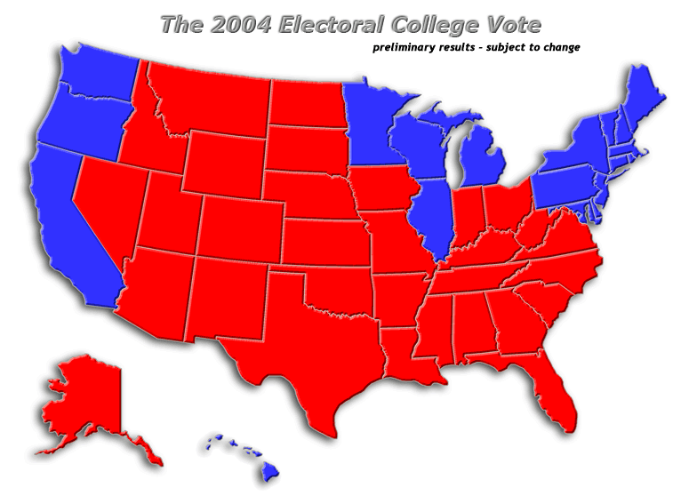
Electoral College Map, 2004

Slide 65
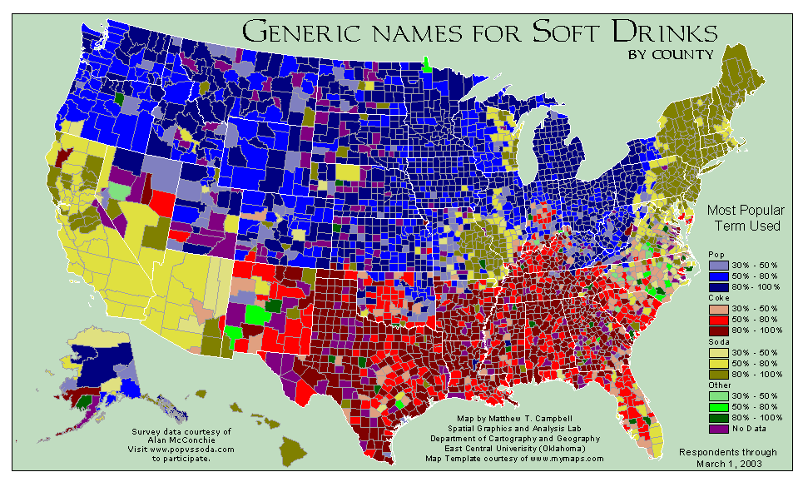
Pop v. Coke v. Soda

